Slide 1


Kardelen Geçkin
November 2026

Slide 2

Outline
Executive Summary
Introduction
Methodology
Results
Conclusion
Appendix

Slide 3
Executive Summary
Data collected from SpaceX API, public launch tables and course datasets.
Analysis used Python, SQL, Folium, Plotly Dash and four classifiers.
All four models scored 83.3% on a small 18-record test set.

Slide 4
Introduction
Falcon 9 first-stage recovery is a key enabler of reusable launch operations.
Research question: Can historical launch attributes predict landing success?
Investigate launch site, orbit, payload, flight number and booster characteristics.

Slide 5

Section 1

Slide 6
Methodology
Data collection: SpaceX API and Wikipedia tables.
Preparation: missing values, landing outcomes and binary Class label.
Exploration: Python charts and SQL queries.
Interactivity: Folium location maps and Dash filters.
Prediction: tuned Logistic Regression, SVM, Decision Tree and KNN.

Slide 7
Data Collection
SpaceX REST endpoints and historical launch tables.
IBM coursework CSV files for SQL, mapping and dashboard exercises.
The notebooks use related but not always identical datasets.

Slide 8
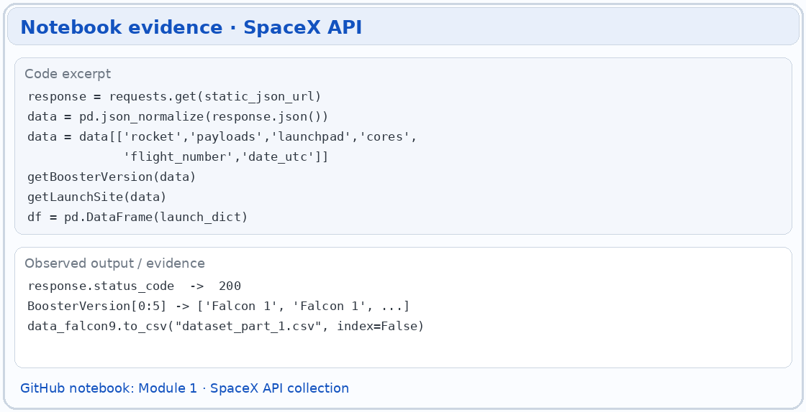
Data Collection – SpaceX API
REST requests return launch records as JSON.
Resolve rocket, payload and launchpad attributes.
Normalize fields into Pandas tables.
SpaceX REST API
JSON launch + rocket fields
Pandas normalization
Tabular dataset
GitHub notebook link

Slide 9
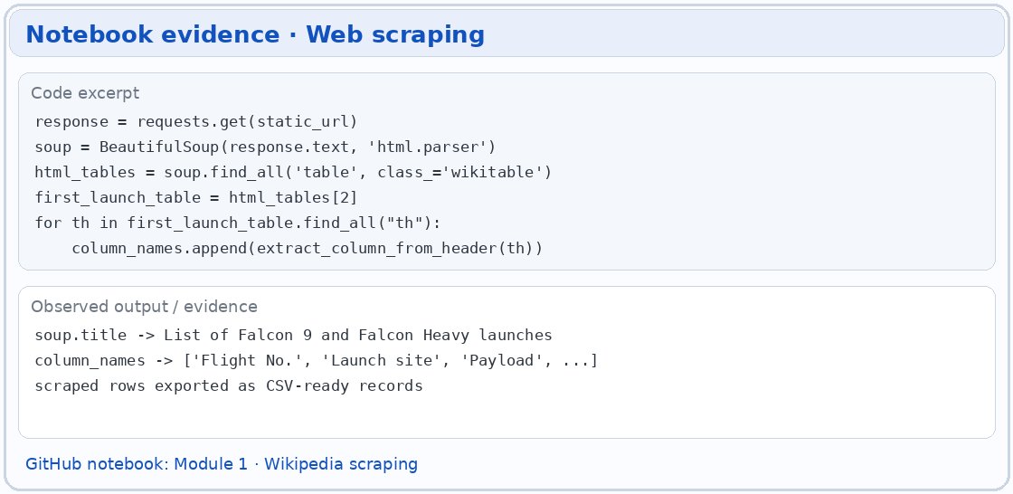
Data Collection - Scraping
Read Wikipedia Falcon 9 tables.
Parse rows with BeautifulSoup.
Clean headers and export structured CSV.
Public launch tables
HTML / BeautifulSoup
Clean row values
CSV output
GitHub notebook link

Slide 10
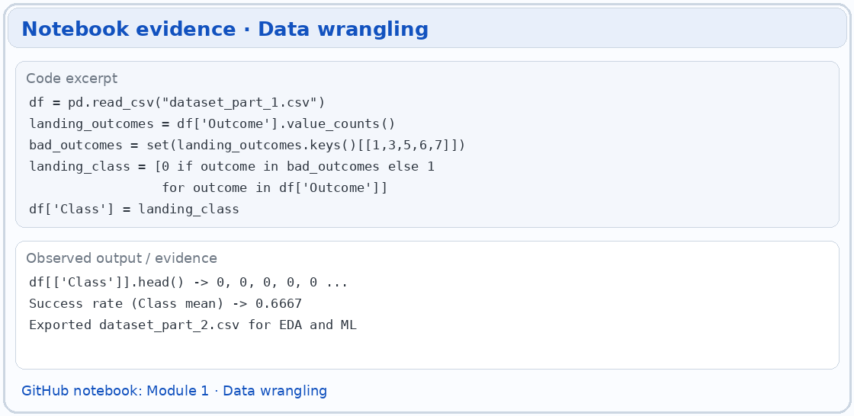
Data Wrangling
Extract the first-stage landing outcome.
Map outcomes to binary Class: successful landing = 1; otherwise = 0.
Handle missing, inconsistent and categorical fields.
Open the source notebook / script on GitHub

Slide 11
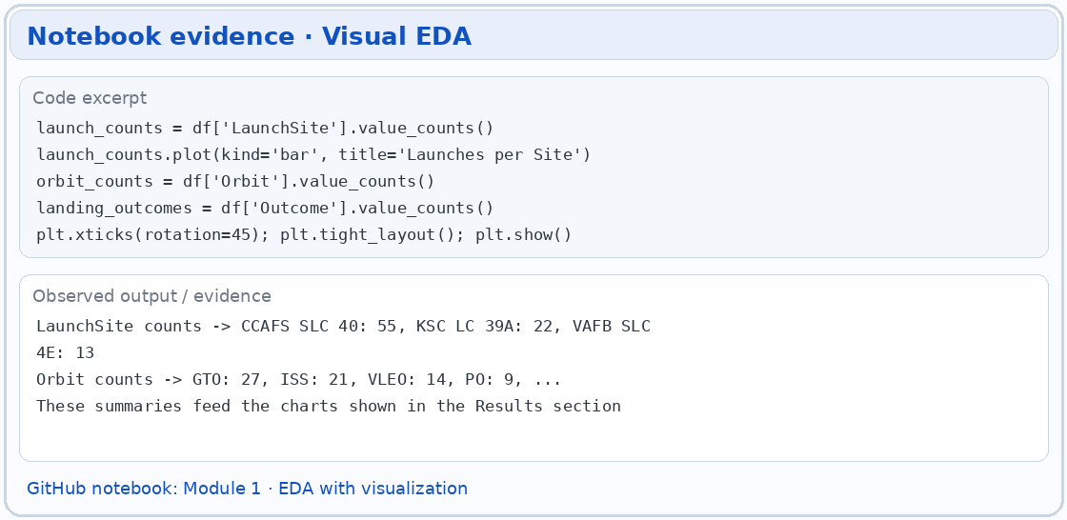
EDA with Data Visualization
Compare launch site, payload mass, orbit and flight number.
Analyze yearly landing rates and category counts.
Plots reveal correlations, not causes.
Open the source notebook / script on GitHub

Slide 12
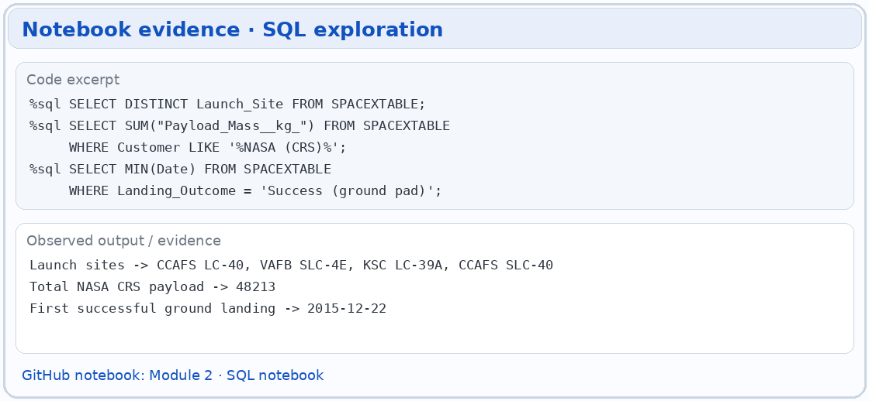
EDA with SQL
DISTINCT launch sites and CCAFS record filters.
SUM and AVG payload calculations, earliest ground landing.
Drone ship outcomes, maximum payload and date-ranked results.
Open the source notebook / script on GitHub

Slide 13
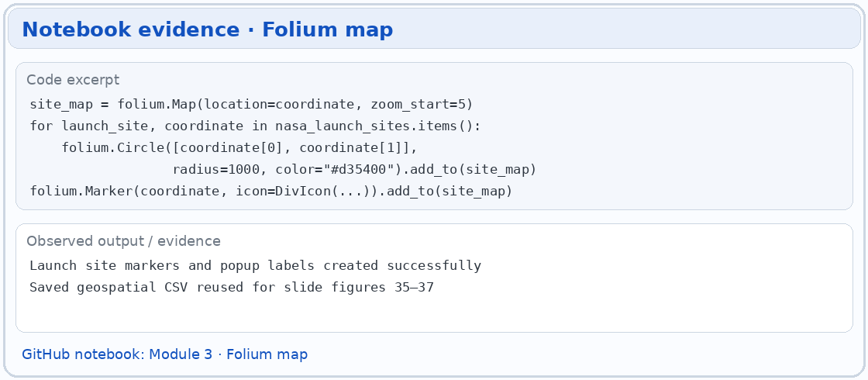
Build an Interactive Map with Folium
Map launch sites using latitude and longitude.
Color outcomes and add site markers.
Inspect approximate distance to local transport and coastal features.
Open the source notebook / script on GitHub

Slide 14
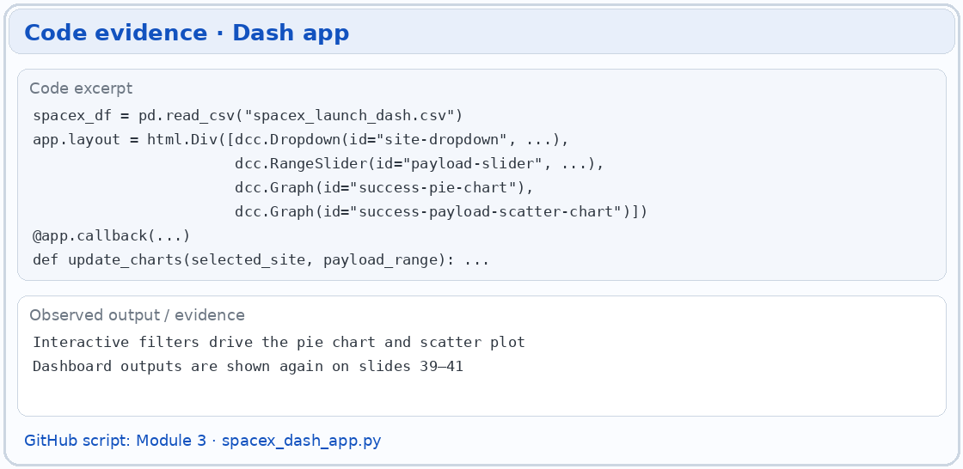
Build a Dashboard with Plotly Dash
Launch-site dropdown changes success/failure pie chart.
Payload range slider filters a scatter plot.
Color and hover data help compare outcomes and booster versions.
Open the source notebook / script on GitHub

Slide 15
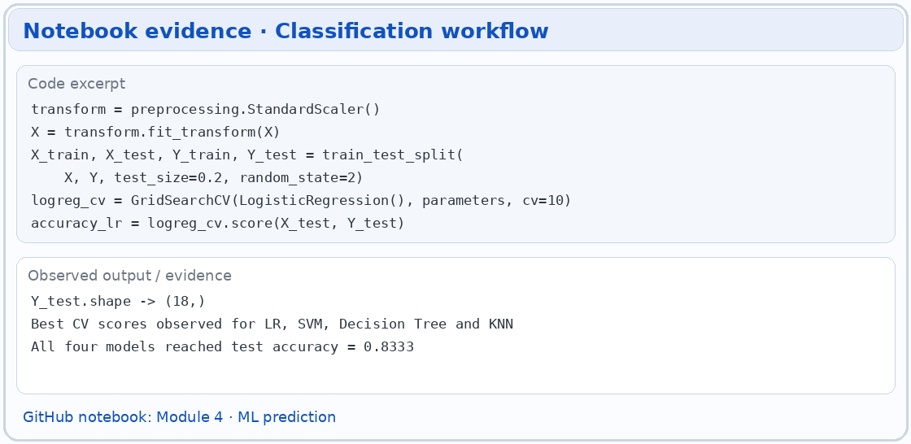
Predictive Analysis (Classification)
Encode predictors and split into training and held-out test sets.
Tune Logistic Regression, SVM, Decision Tree and KNN by cross-validation.
Compare both test accuracy and confusion matrix errors.
Open the source notebook / script on GitHub

Slide 16
Results
EDA: launch history, orbit and payload patterns.
Interactive analysis: geographic launch sites and dashboard filters.
Predictive modeling: four classifiers on the same holdout sample.

Slide 17

Section 2

Slide 18
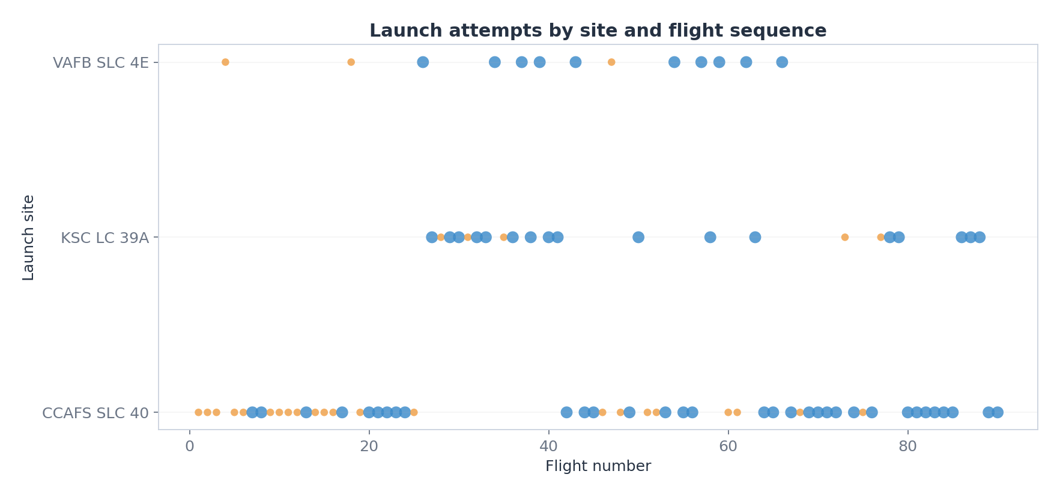
Flight Number vs. Launch Site
Later flights contain more successful landings. Site histories differ.
Visualization from course-provided 90-row modeling dataset.

Slide 19
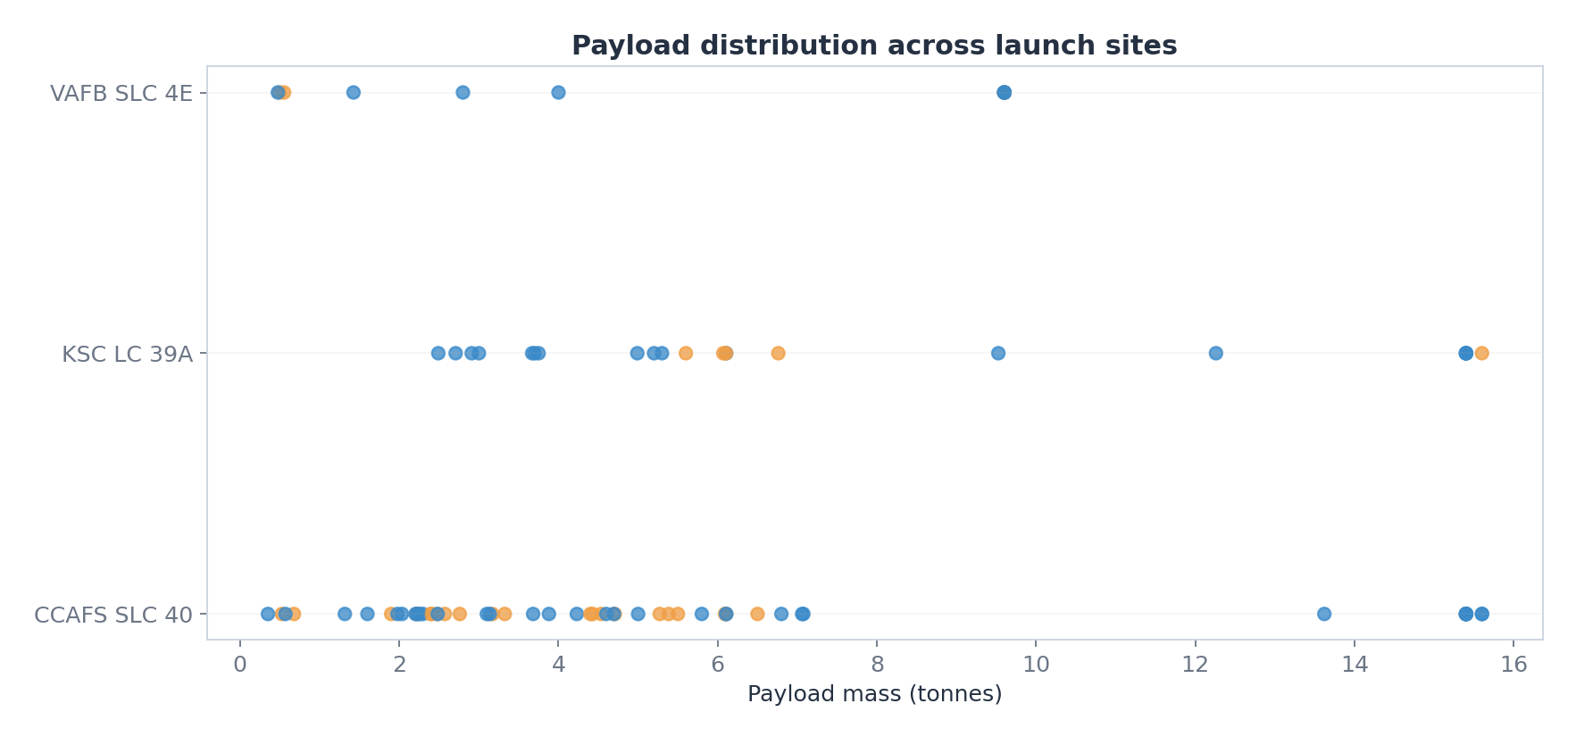
Payload vs. Launch Site
Payload masses overlap between successful and unsuccessful landings.
Visualization from course-provided 90-row modeling dataset.

Slide 20
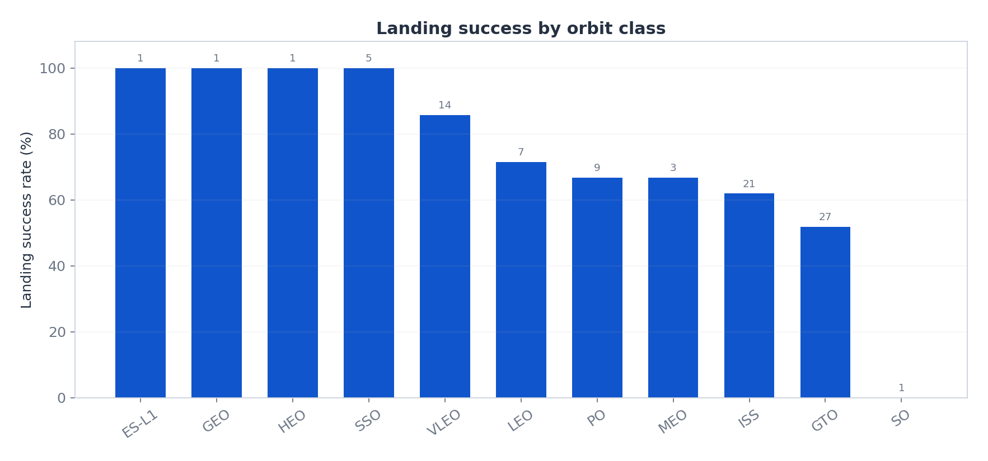
Success Rate vs. Orbit Type
Landing success varies by orbit category. Small group counts matter.
Visualization from course-provided 90-row modeling dataset.

Slide 21
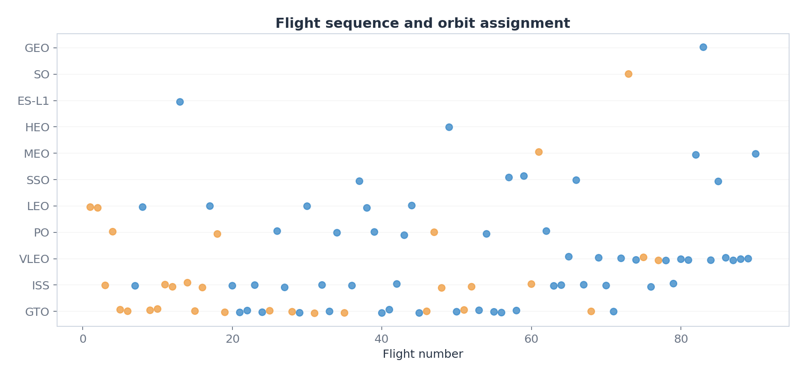
Flight Number vs. Orbit Type
Orbit profiles change across the historical launch sequence.
Visualization from course-provided 90-row modeling dataset.

Slide 22
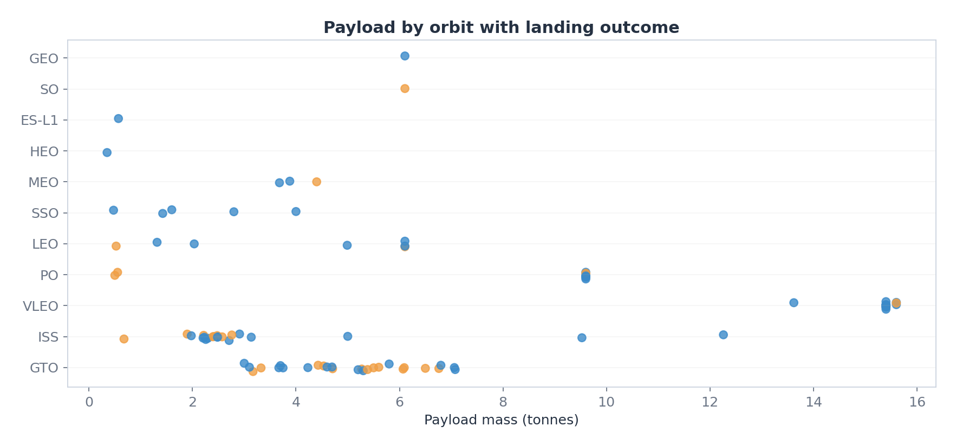
Payload vs. Orbit Type
Payload ranges differ by mission orbit; outcomes still overlap.
Visualization from course-provided 90-row modeling dataset.

Slide 23
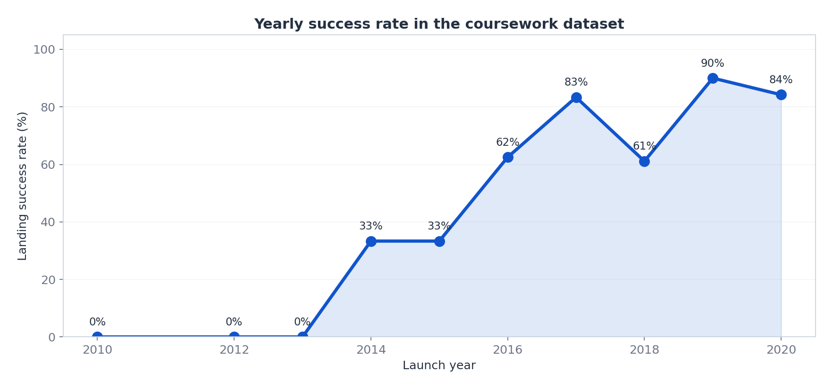
Launch Success Yearly Trend
The sample shows an improving landing trend across launch years.
Visualization from course-provided 90-row modeling dataset.

Slide 24
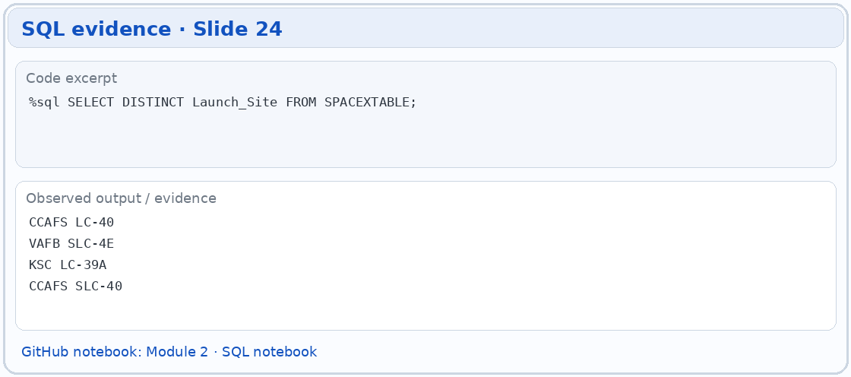
All Launch Site Names
Unique launch-site strings in the SQL coursework data:
CCAFS LC-40 | VAFB SLC-4E
KSC LC-39A | CCAFS SLC-40
Distinct strings may include naming variants.
Open the source notebook / script on GitHub

Slide 25
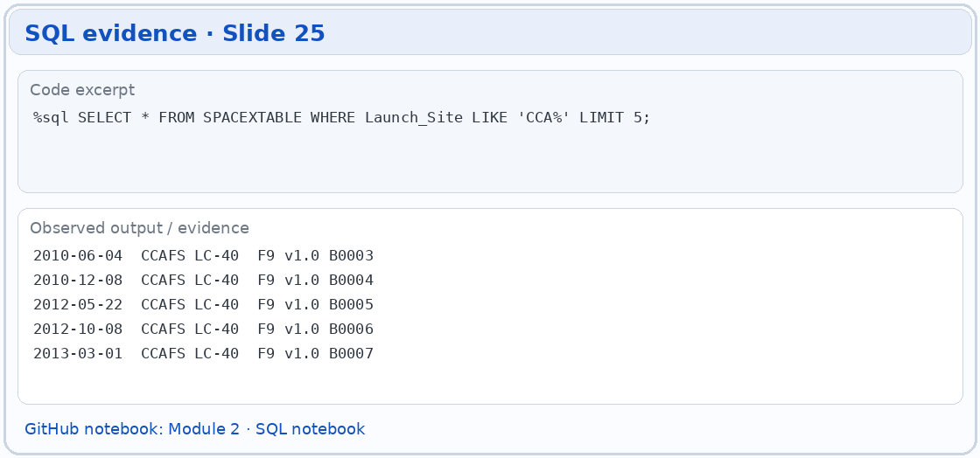
Launch Site Names Begin with 'CCA'
Query: Launch_Site LIKE 'CCA%' LIMIT 5
2010-06-04 CCAFS LC-40 F9 v1.0 B0003
2010-12-08 CCAFS LC-40 F9 v1.0 B0004
2012-05-22 CCAFS LC-40 F9 v1.0 B0005
2012-10-08 CCAFS LC-40 F9 v1.0 B0006
2013-03-01 CCAFS LC-40 F9 v1.0 B0007
Open the source notebook / script on GitHub

Slide 26
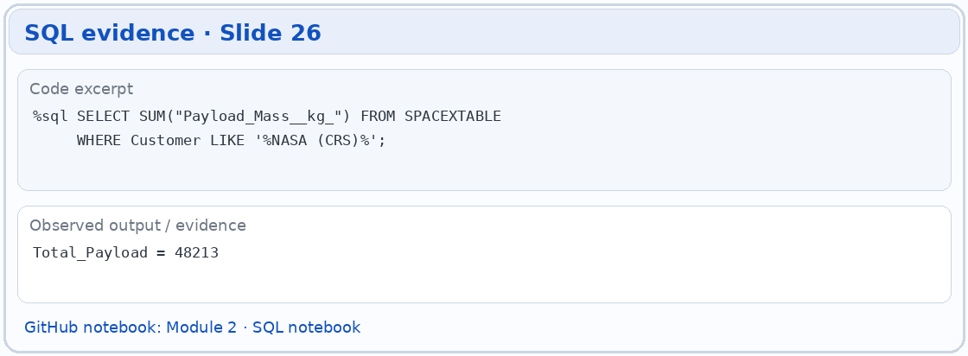
Total Payload Mass
48,213 kg
Total payload for rows with customer matching NASA (CRS).
SQL: SUM(Payload_Mass__kg_) WHERE Customer LIKE '%NASA (CRS)%'.
Source: recorded course SQL notebook output.
Open the source notebook / script on GitHub

Slide 27
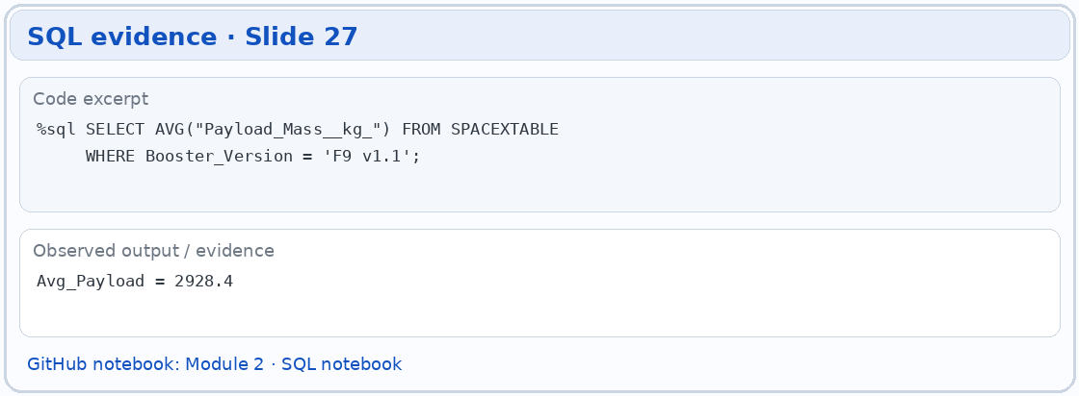
Average Payload Mass by F9 v1.1
2,928.4 kg
Notebook output for AVG(Payload_Mass__kg_) using Booster_Version = 'F9 v1.1'.
This is the normalized SQL notebook result; raw CSV labels can differ.
Open the source notebook / script on GitHub

Slide 28
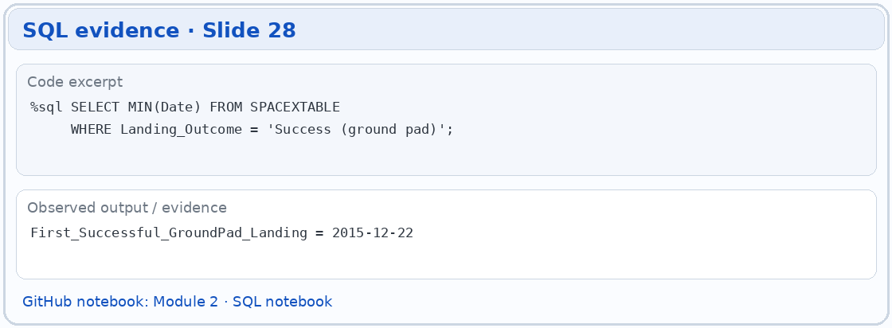
First Successful Ground Landing Date
22 December 2015
Earliest successful ground pad landing in the SQL records.
Query: MIN(Date) where Landing_Outcome = 'Success (ground pad)'.
Open the source notebook / script on GitHub

Slide 29
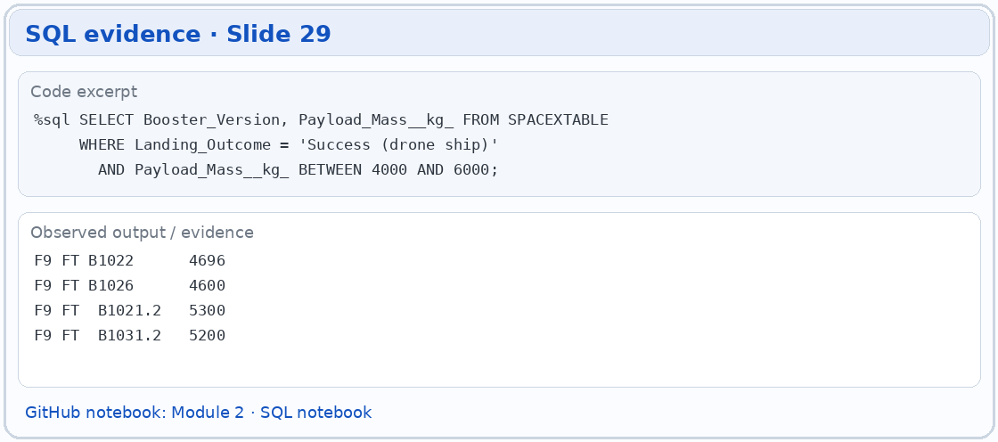
Successful Drone Ship Landing with Payload between 4000 and 6000
Successful drone ship outcomes with payload strictly between 4,000 and 6,000 kg:
F9 FT B1022 | 4,696 kg
F9 FT B1026 | 4,600 kg
F9 FT B1021.2 | 5,300 kg
F9 FT B1031.2 | 5,200 kg
Open the source notebook / script on GitHub

Slide 30
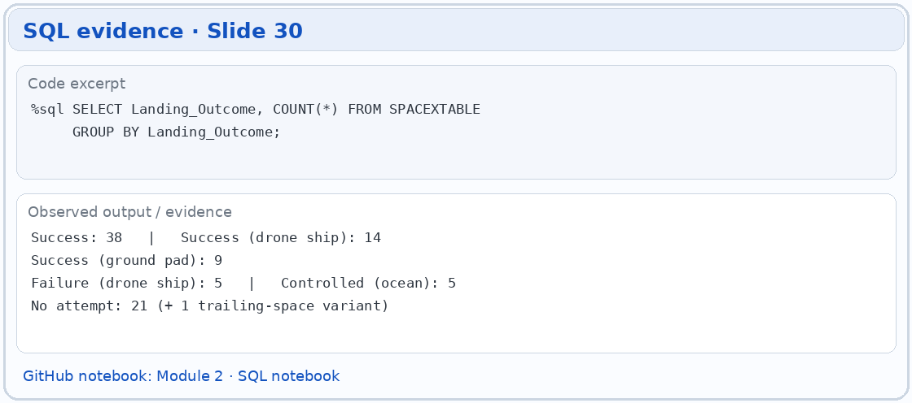
Total Number of Successful and Failure Mission Outcomes
Landing outcomes are not binary in the historic SQL table.
Examples: Success, Success (drone ship), Failure (drone ship),
Success (ground pad), No attempt and Controlled (ocean).
The classifier later uses a separate binary landing label.
Open the source notebook / script on GitHub

Slide 31
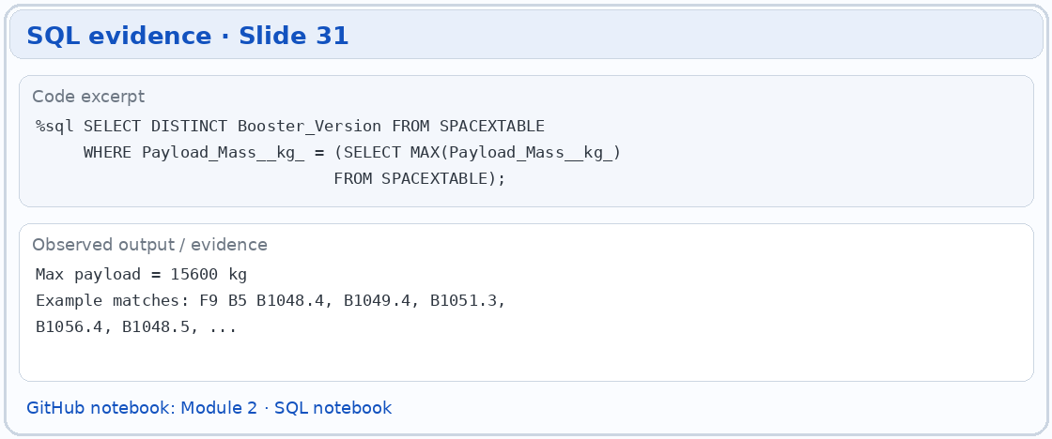
Boosters Carried Maximum Payload
Maximum payload in the saved SQL source: 15,600 kg.
Examples of tied booster records:
F9 B5 B1048.4 | F9 B5 B1049.4 | F9 B5 B1051.3
F9 B5 B1056.4 | F9 B5 B1048.5
SQL returns additional boosters tied at this maximum.
Open the source notebook / script on GitHub

Slide 32
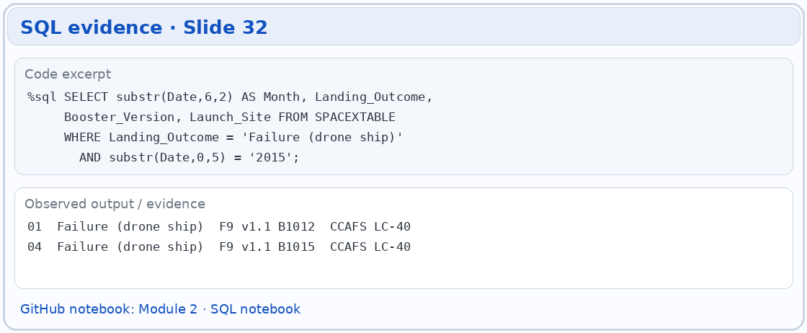
2015 Launch Records
2015 failed drone ship landings in the notebook:
January | F9 v1.1 B1012 | CCAFS LC-40
April | F9 v1.1 B1015 | CCAFS LC-40
Two matching records.
Open the source notebook / script on GitHub

Slide 33
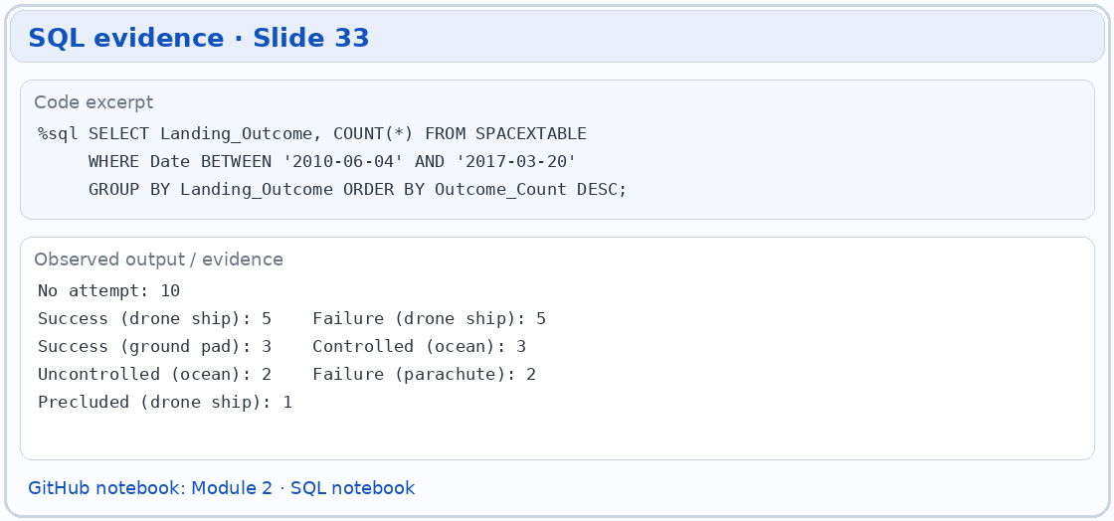
Rank Landing Outcomes Between 2010-06-04 and 2017-03-20
No attempt: 10 | Success (drone ship): 5
Failure (drone ship): 5 | Success (ground pad): 3
Controlled (ocean): 3 | Uncontrolled (ocean): 2
Failure (parachute): 2 | Precluded (drone ship): 1
Date filter: 04 Jun 2010 through 20 Mar 2017.
Open the source notebook / script on GitHub

Slide 34

Section 3

Slide 35
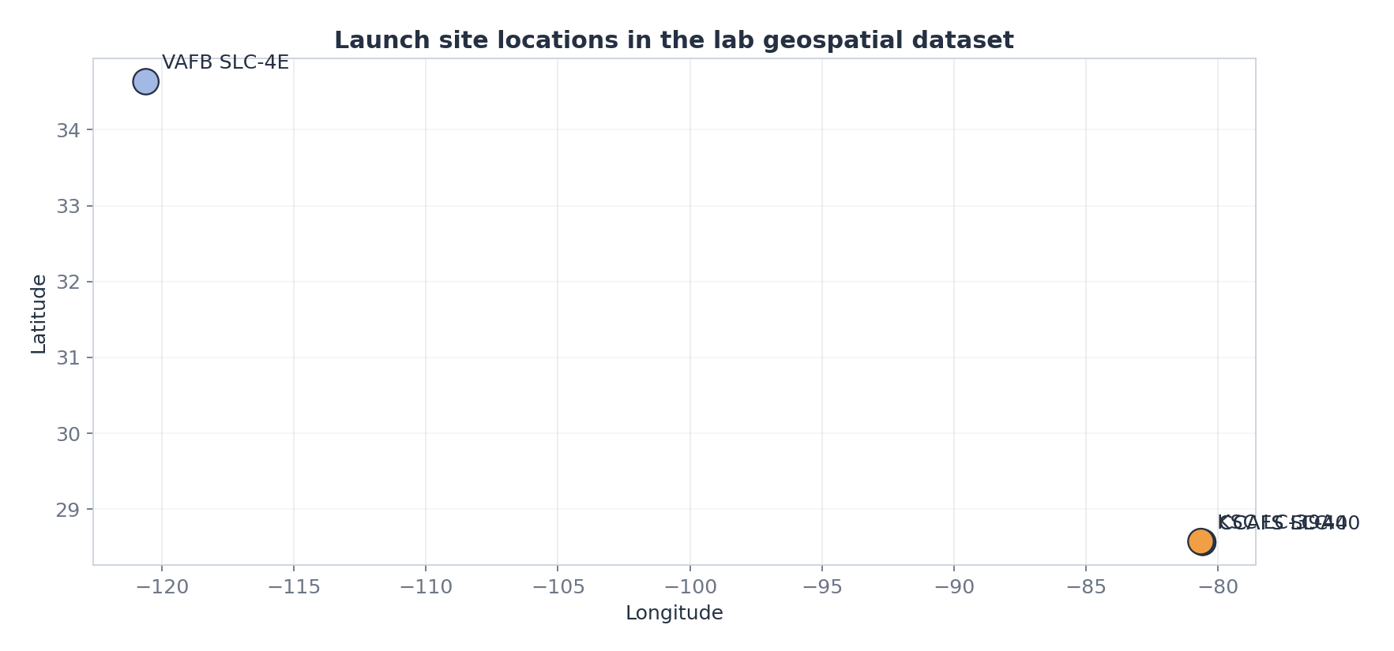
Launch Site Locations
Saved geospatial coordinates show launch-site locations.
Chart reconstructed from lab CSV, not a live Folium screenshot.

Slide 36
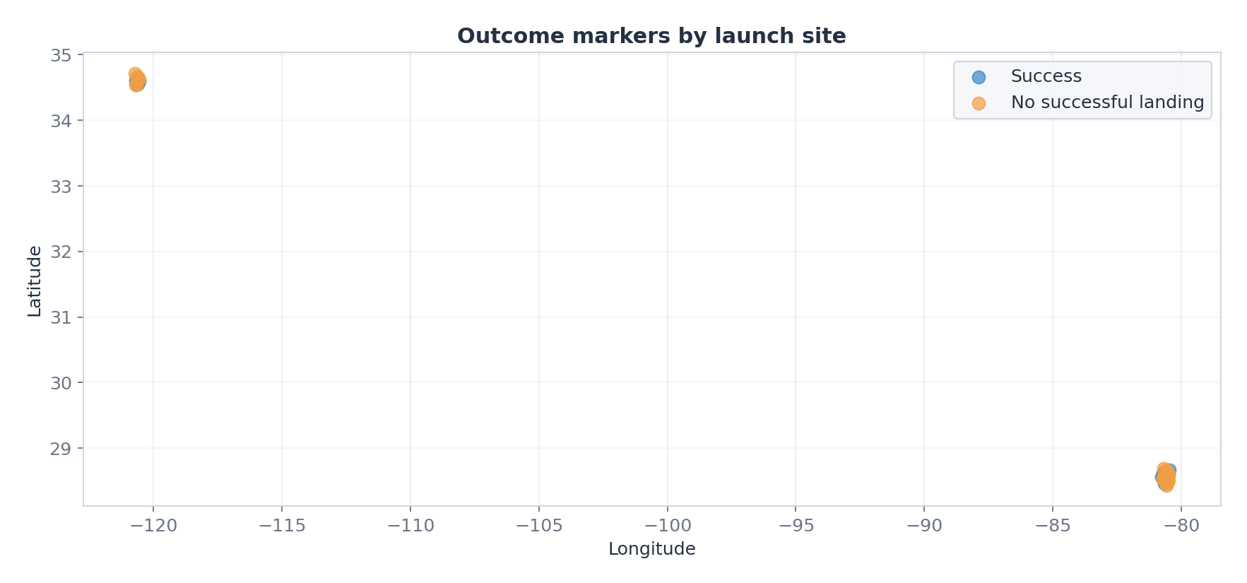
Landing Outcomes by Site
Success and failure outcomes are color-coded by site.
Reconstructed plot from the saved geospatial dataset.

Slide 37
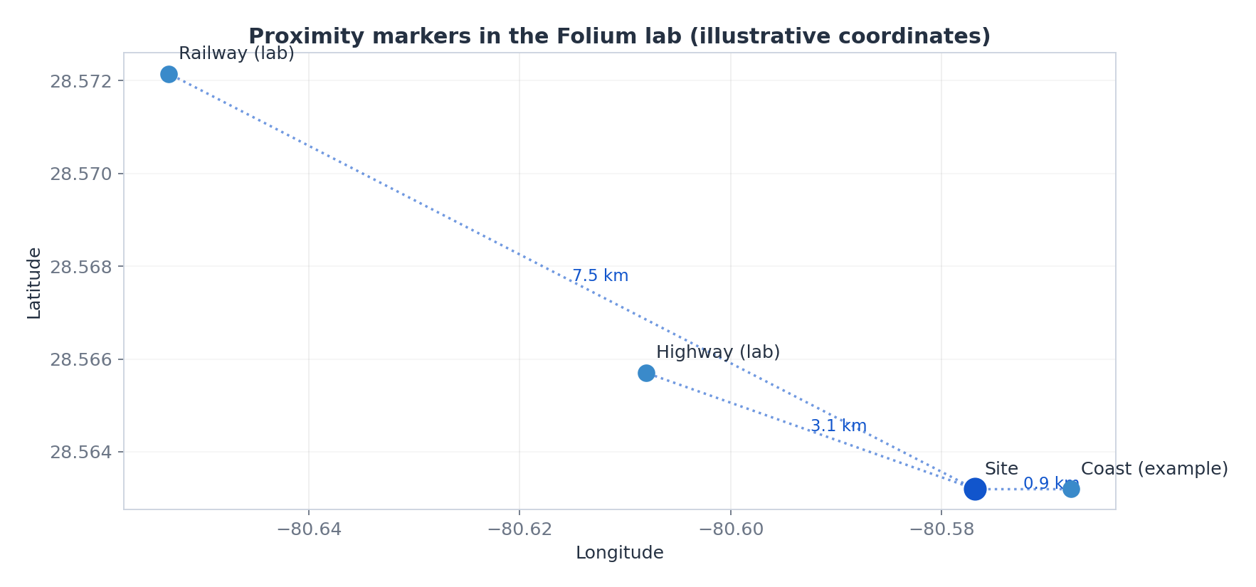
Launch Site Proximity
Illustrative coast, railway and road proximity measurements.
Approximate distances, not surveyed geographic distances.

Slide 38

Section 4

Slide 39
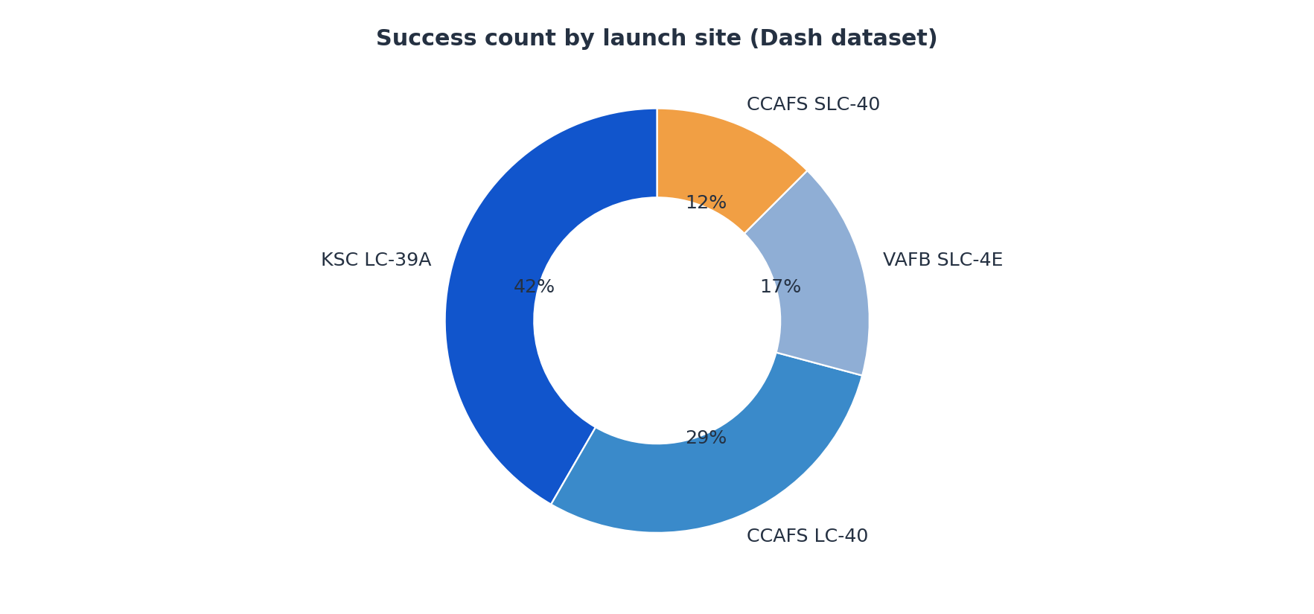
Landing Success Count by Site
Successful landings are grouped by launch site.
Slices show share of successes, not each site success rate.

Slide 40
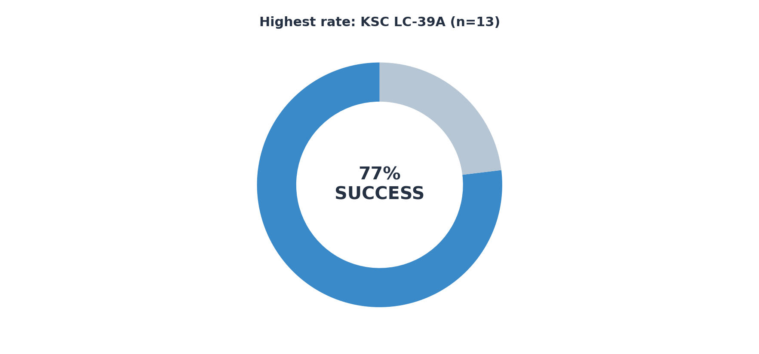
Highest Site Success Ratio
Per-site ratio: successful landings / total attempts.
Reconstructed from 56-record Dash dataset.

Slide 41
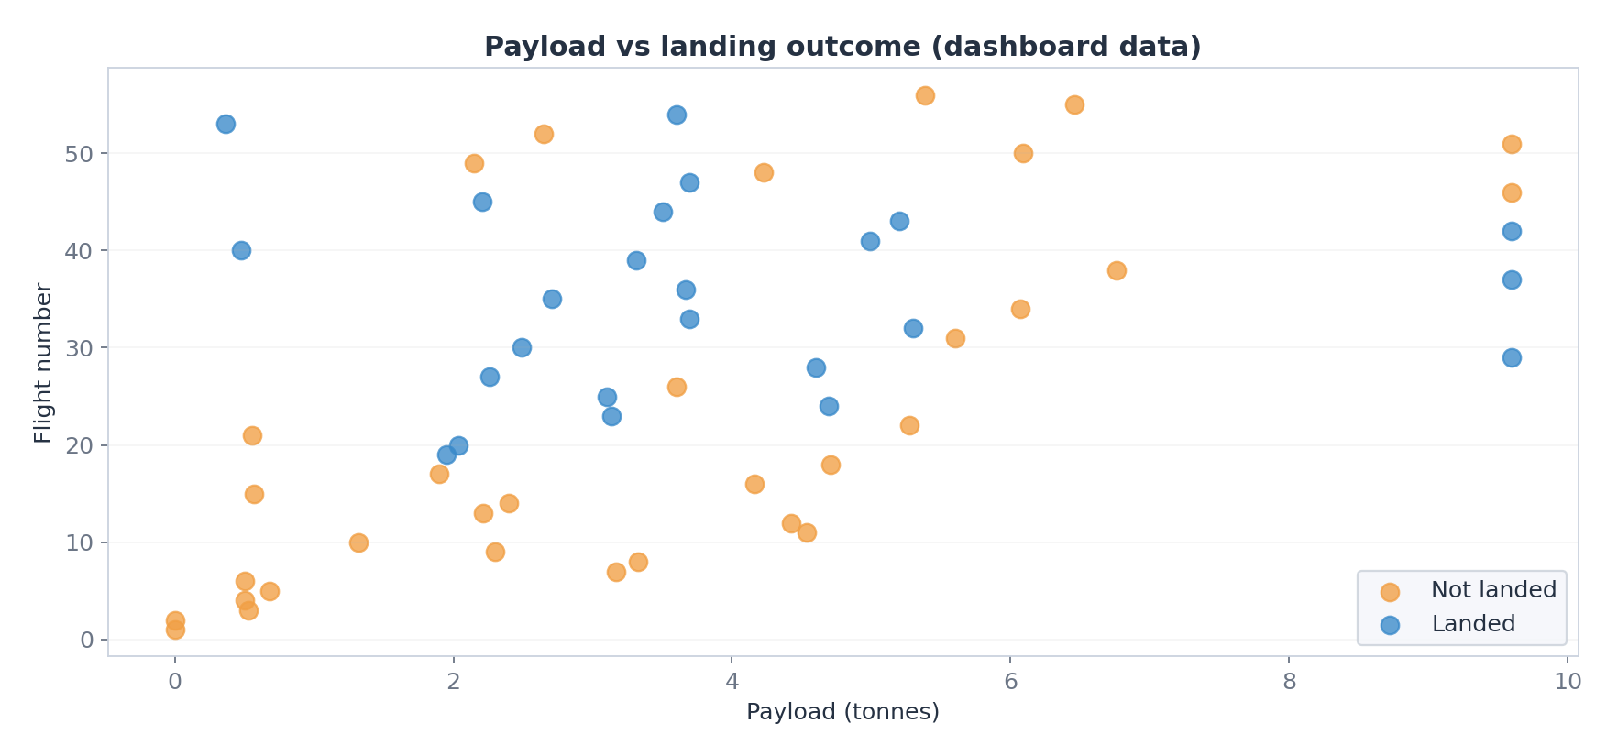
Payload and Launch Outcome
Scatter plot separates success vs. failure.
Original app provides site and payload-range filters.

Slide 42

Section 5

Slide 43
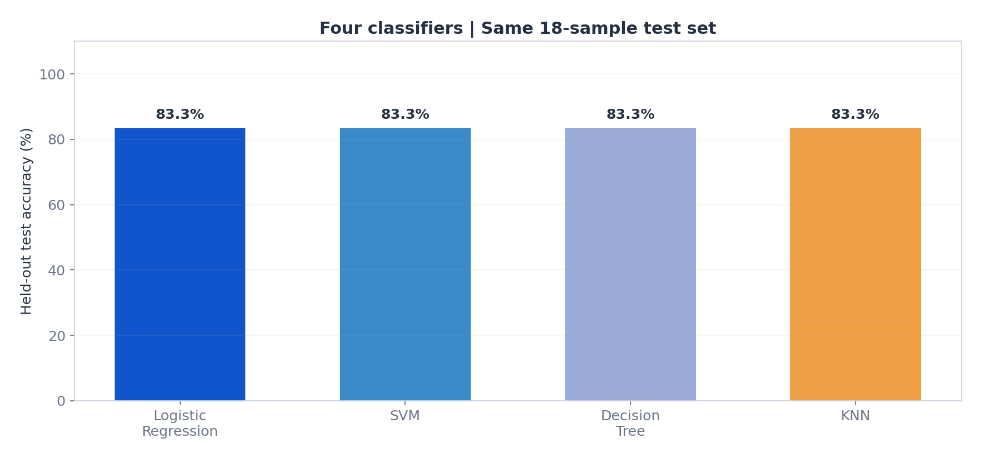
Classification Accuracy
Test split: 18 launch records.
Logistic Regression, SVM, Decision Tree and KNN: 83.3% accuracy.
Decision Tree leads cross-validation, but tied on held-out data.

Slide 44
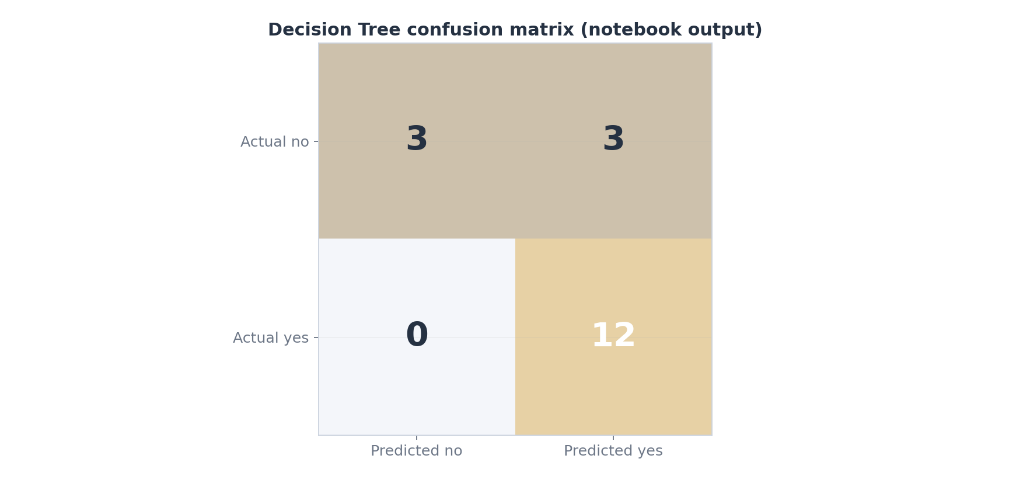
Confusion Matrix
Decision Tree confusion matrix from notebook:
TN = 3 FP = 3
FN = 0 TP = 12
Accuracy = 15 / 18 = 83.3%.
Positive recall = 100%; specificity = 50%.

Slide 45
Conclusions
Historical landing success improves with flight sequence in these records.
Landing outcome also varies by orbit, mission and launch site.
All four models tie on a small 18-sample test set.
Interpret accuracy with cross-validation and confusion matrix.
This educational analysis is not a live launch-risk model.

Slide 46
Appendix
Source notebooks and reproducibility:
Module 1: SpaceX REST API, web scraping and data wrangling.
Module 2: SQL data exploration.
Module 3: Folium mapping and Plotly Dash dashboard.
Module 4: model tuning and confusion matrix.
GitHub: github.com/kgeckin/IBM_Applied_Data_Science_Capstone

Slide 47


